Slide 2
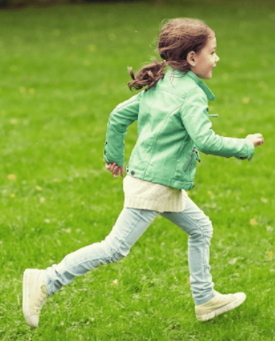
5
My hobbies
LESSON 1
Period 1

Slide 3
Contents
03
Listen, point and say.
01
Warm-up
04
Let’s talk.
02
Look, listen and repeat.
05
Fun corner and wrap-up

Slide 4
1 Warm-up
Let’s play a game.
Notes:
Review Numbers 1-10 and Alphabet

Slide 5
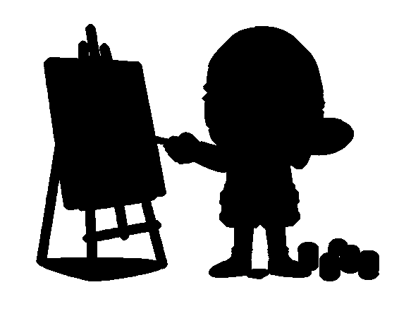
1
2
3
4
Action simulation
Notes:
- T shows picture.
- T asks some pupils who can simulate the actions in the pictures through the shadows. -> Choose the best ones and gives them points.

Slide 6
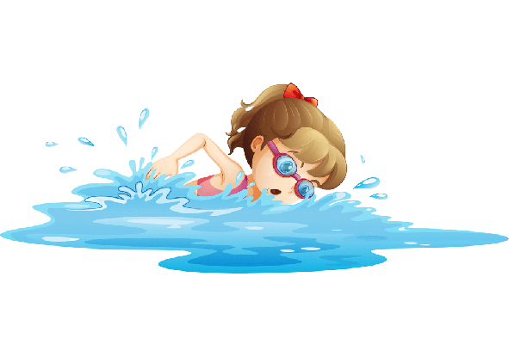
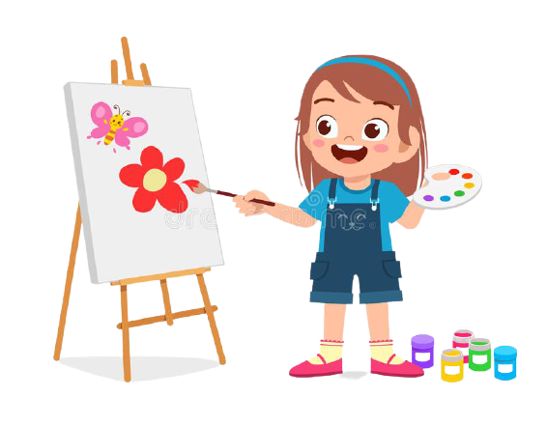
1
2
3
4
a
b
c
d
Notes:
- T asks pupils to match the pictures with their shadows in mind first (whole class).
- T says the numbers, pupils say the letters. -> Check the answers in the next slide.

Slide 7
1
2
3
4
a
d
c
b
Notes:
- T says the numbers 1 by 1 and click to shows the answer.

Slide 8
dancing
Notes:
T shows the shadows with their pictures and say the words and gives sentences: They are ____., She is _____., He is _____.

Slide 9
drawing
Notes:
T shows the shadows with their pictures and say the words and gives sentences: They are ____., She is _____., He is _____.

Slide 10
singing
Notes:
T shows the shadows with their pictures and say the words and gives sentences: They are ____., She is _____., He is _____.

Slide 11
swimming
Notes:
T shows the shadows with their pictures and say the words and gives sentences: They are ____., She is _____., He is _____.

Slide 12
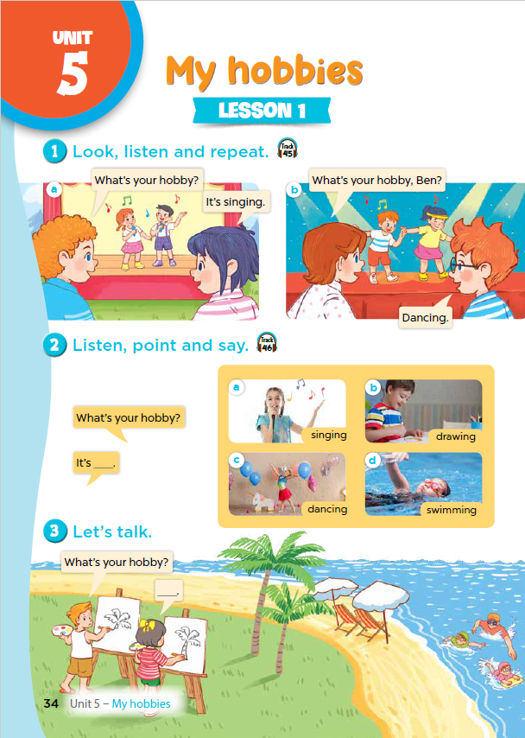
Notes:
T asks pupils to open their SB/ page 34.

Slide 13
2 Look, listen and repeat.

Slide 14
Notes:
Step 1: Ask pupils to look at context a. Play the recording for them to listen. Play the recording again, sentence by sentence, for them to listen and repeat. Correct pronunciation if necessary.
Step 2: Do the same with context b.
Step 4: Work in pair - role play.
Step 5: Invite few pairs to the front of the class and act.

Slide 15
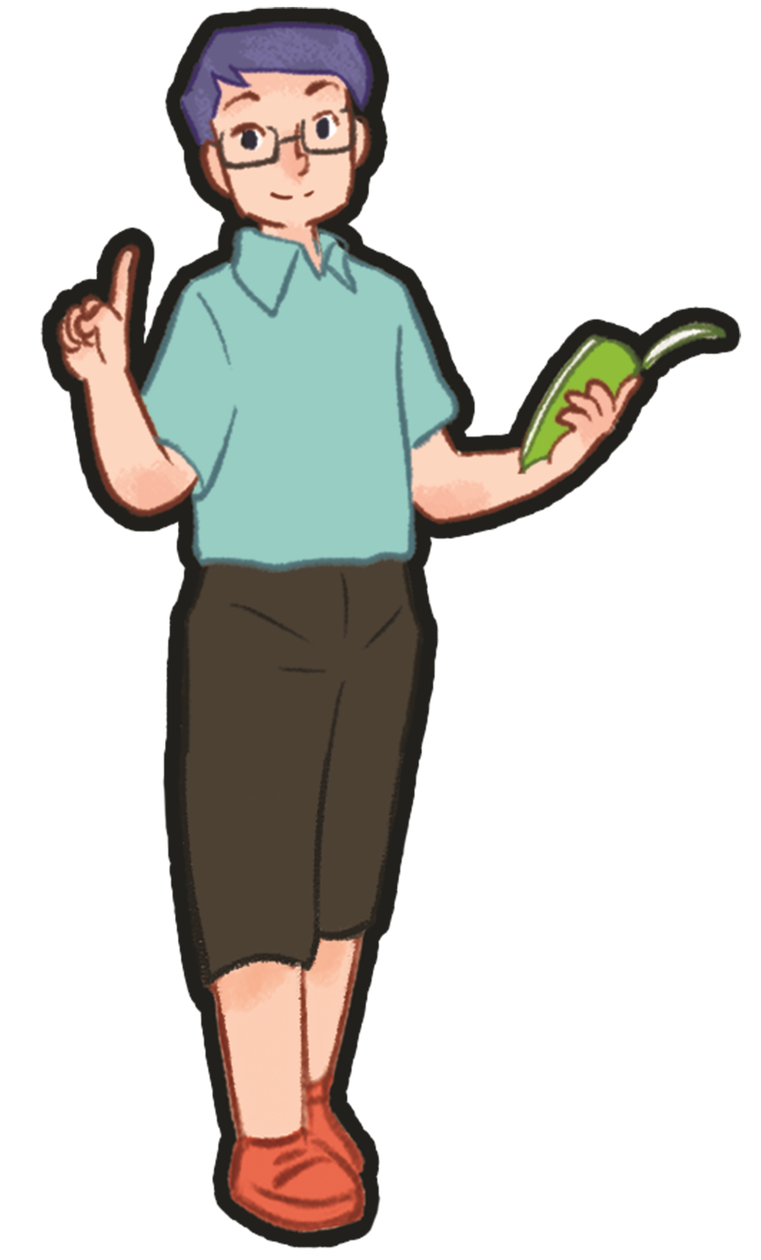
2 Listen, point and say.

Slide 16
Notes:
Step 1: Have pupils look at the pictures and elicit the names of the pupils. Have the class repeat the words a few time.
Step 2: Ask 2 pupils to do as an example.
Step 4: Ask pupils to work in pairs, pointing to the questions and pictures and giving the answers.
Step 5: Invite few pairs to the front of the class and make questions and answers.

Slide 17
singing

Slide 18
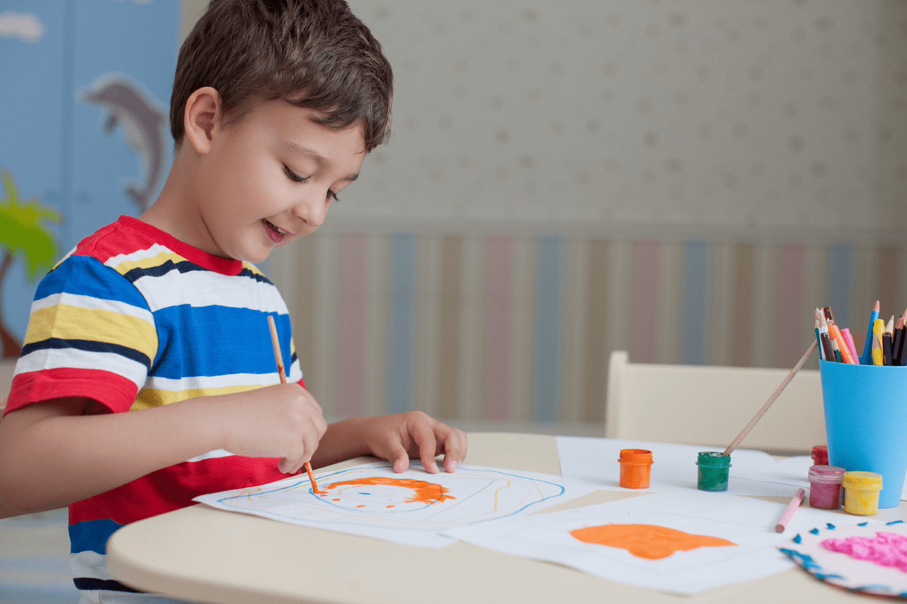
drawing

Slide 19
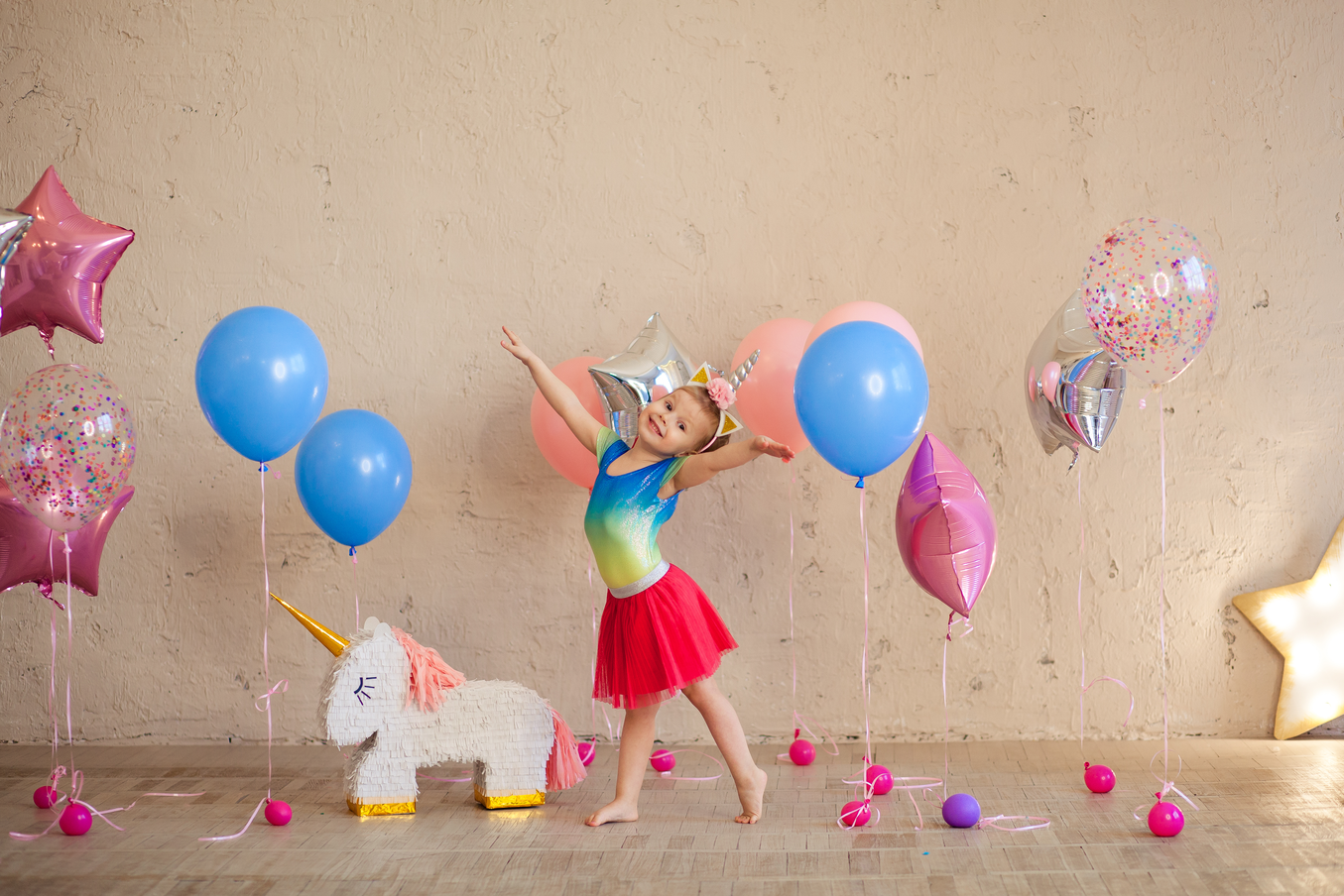
dancing

Slide 20
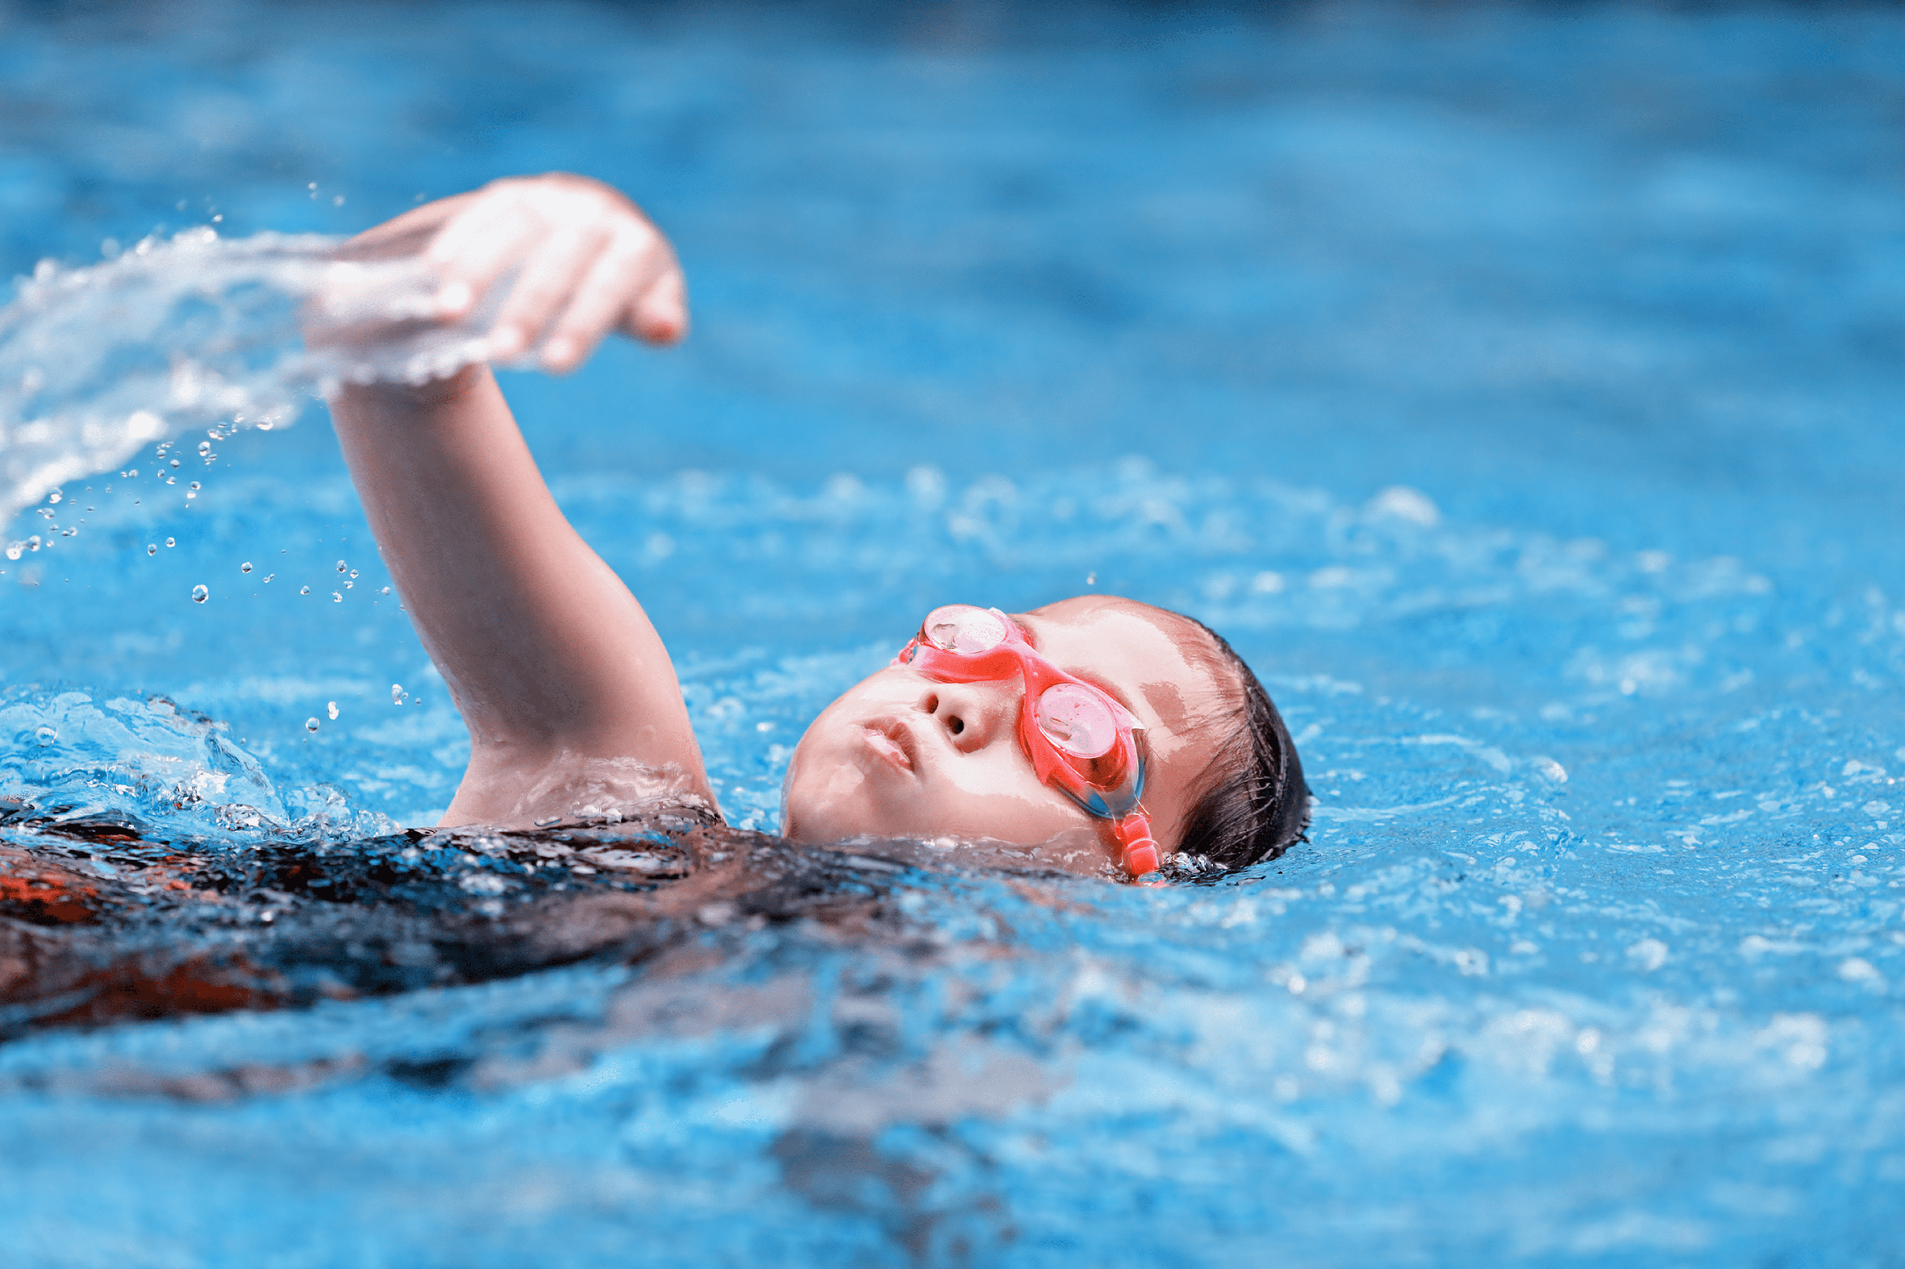
swimming

Slide 21
Notes:
Step 1: Have pupils look at the pictures and elicit the names of the pupils. Have the class repeat the words a few time.
Step 2: Ask 2 pupils to do as an example.
Step 4: Ask pupils to work in pairs, pointing to the questions and pictures and giving the answers.
Step 5: Invite few pairs to the front of the class and make questions and answers.

Slide 22
What’s missing?
Notes:
Game: What’s missing?
Divide the class into 4 groups.
A pupil from each group comes to the front, look at the pictures and say which is missing.
Who say it fast will get points.

Slide 23
What’s missing?

Slide 24
What’s missing?

Slide 25
What’s missing?

Slide 26
What’s missing?

Slide 27
4 Let’s talk.

Slide 29
It’s ____.
What’s your hobby?
Notes:
- T asks pupils to practise in pairs asking and answering.
- T asks some pairs to present in front of class.

Slide 30
Matching game

Slide 31
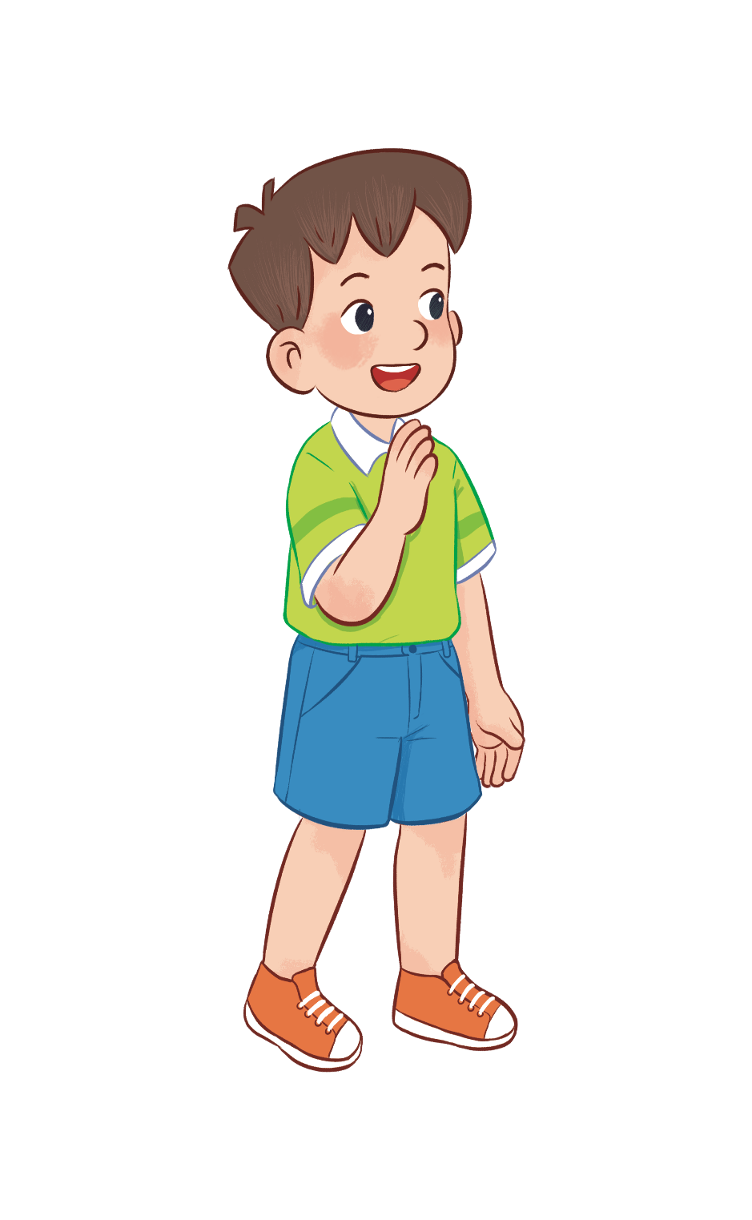
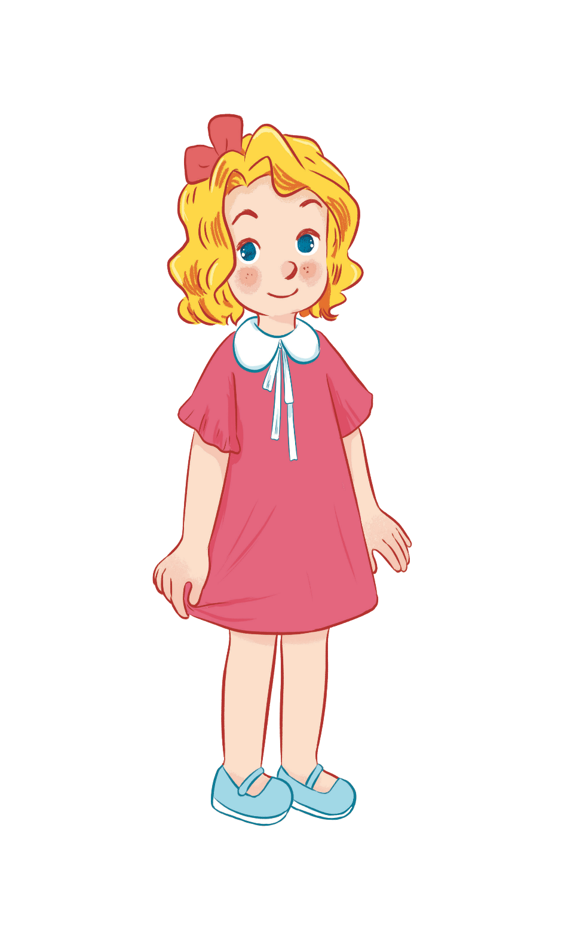
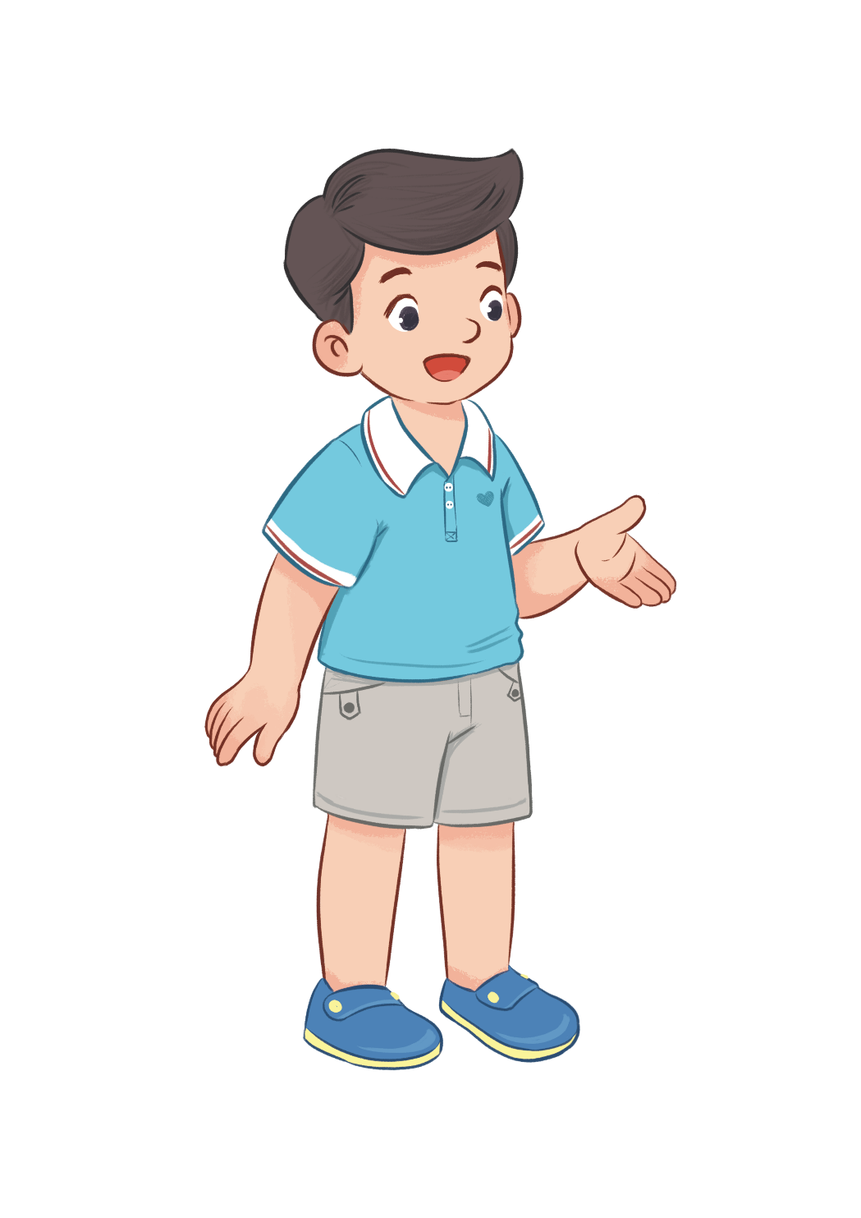
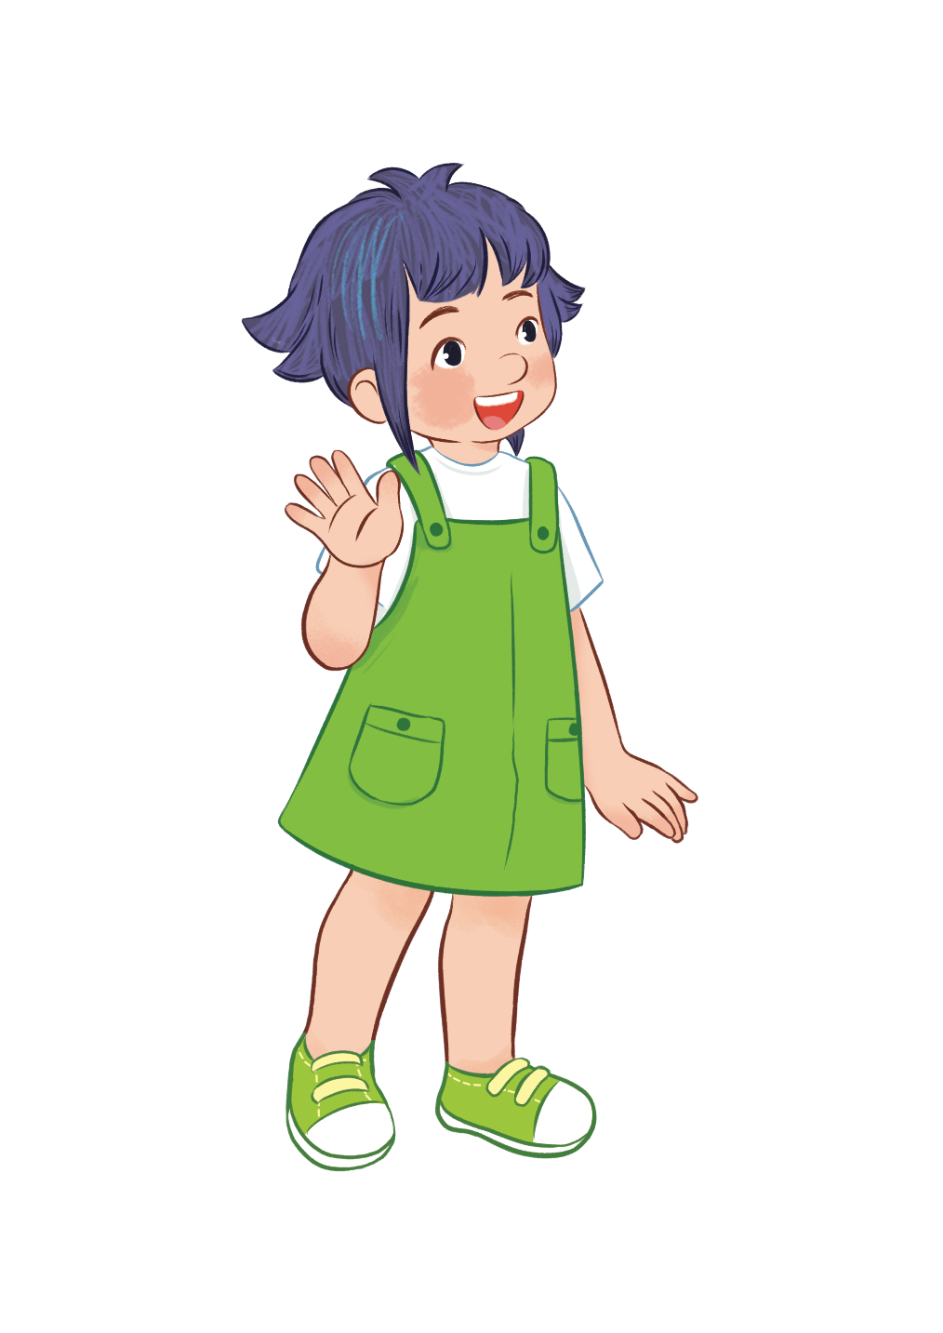
HOBBIES
drawing
swimming
dancing
singing
Notes:
- T writes 4 new words on the board and asks pupils to read (whole class).
- T asks 4 pupils to come to the board and write their hobbies in the pieces of paper and keep them in secret.

Slide 32
swimming/ drawing, ..?
dancing/ singing, ..?
dancing/ singing, ...?
swimming/ drawing, ...?
HOBBIES
drawing
swimming
dancing
singing
Notes:
T asks 1 pupil come to the board and guess their hobbies written in the paper (He has to write the answers in the small pieces of paper and stick to 4 pupils).

Slide 33
It’s swimming.
HOBBIES
drawing
swimming
dancing
singing
What’s your hobby?
swimming
singing
dancing
drawing
Notes:
T asks the pupil to ask the question to find the answers and gives him or her point if correct (repeat the activities depending the time).

Slide 34
5 Fun corner and Wrap-up

Slide 35
Notes:
- T asks 1 student come to the board and face to the class.
- T shows 1 picture of 4 hobbies and lets the others act so that the pupil on the board can guess the name of the hobby in the picture (1 pupil will guess 3 pictures).

Slide 36
What’s your hobby?
Notes:
T shows 4 pictures on the board and asks pupils to repeat -> Wrap up.

Slide 37
Website: hoclieu.vn
Fanpage: facebook.com/www.tienganhglobalsuccess.vn

